Slide 1
Capstone Slideshow

Slide 2
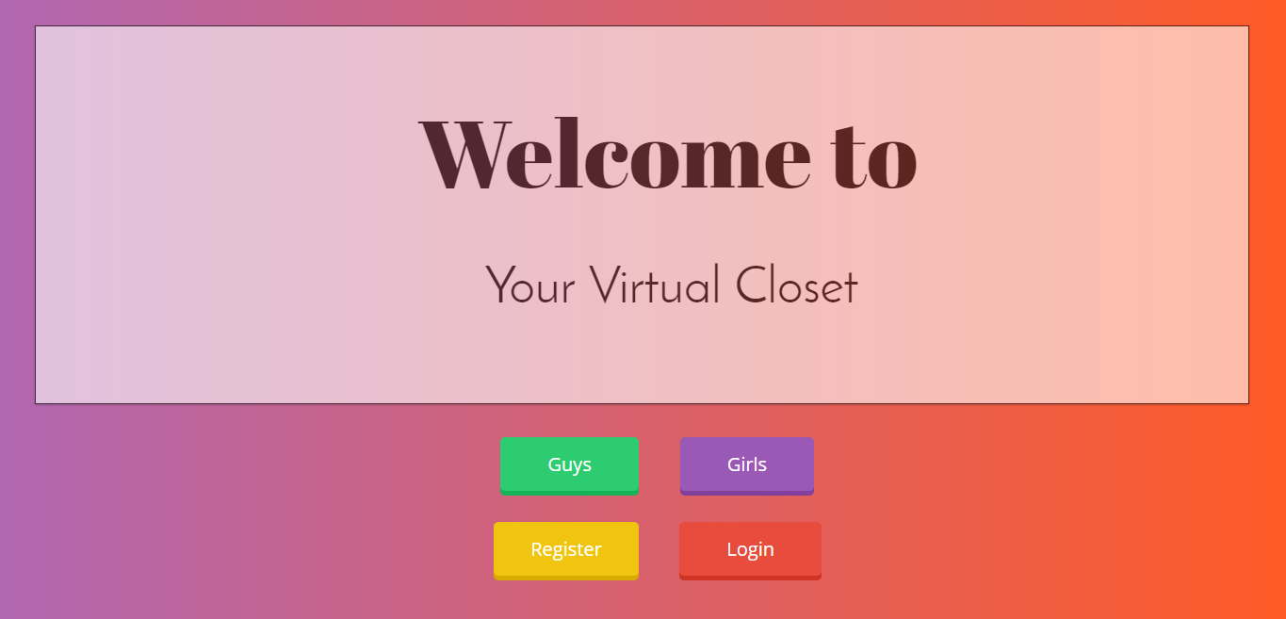
The Home Page

Slide 3
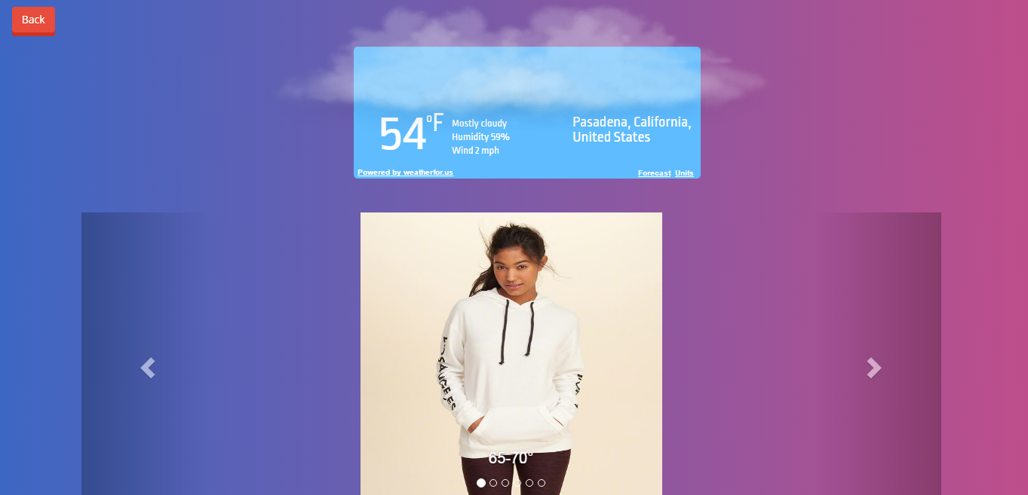
The Girls Page Before

Slide 4
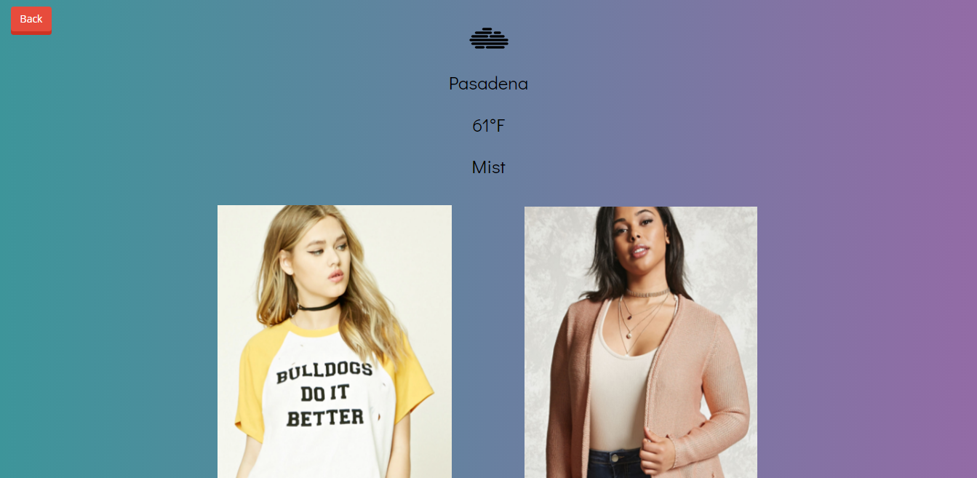
The Girls Page After

Slide 5
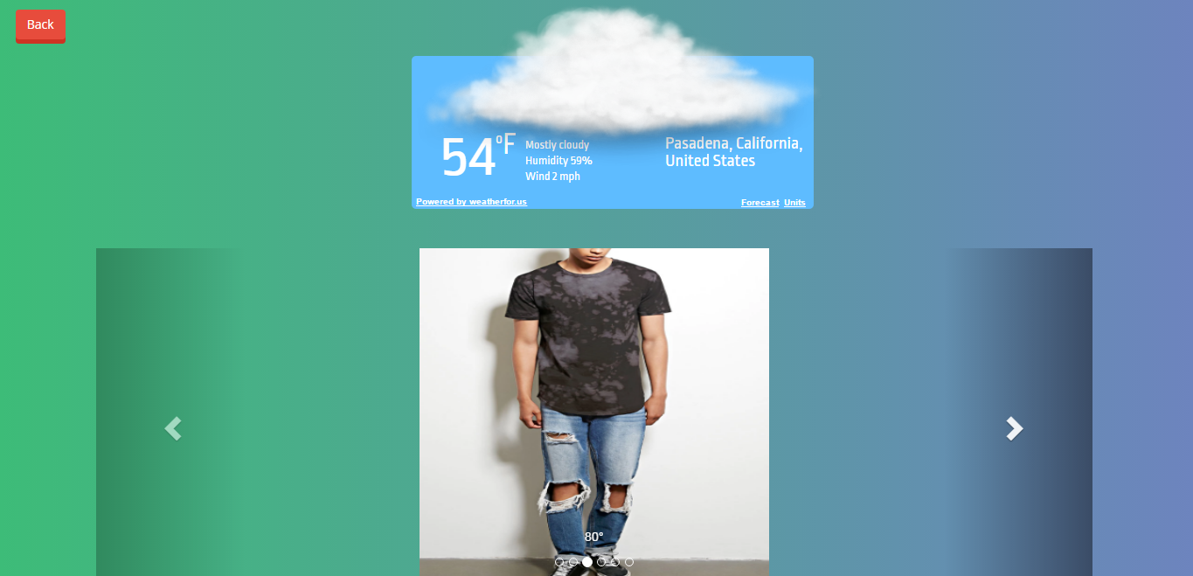
The Guys Page Before

Slide 6
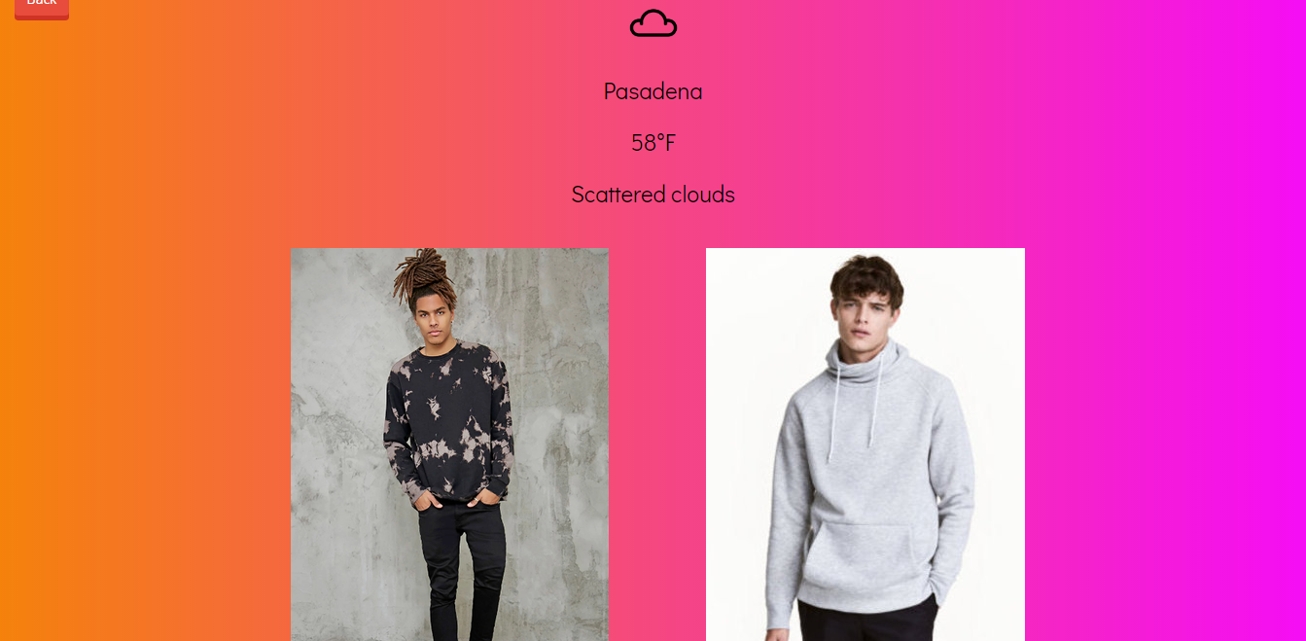
The Guys Page After

Slide 7
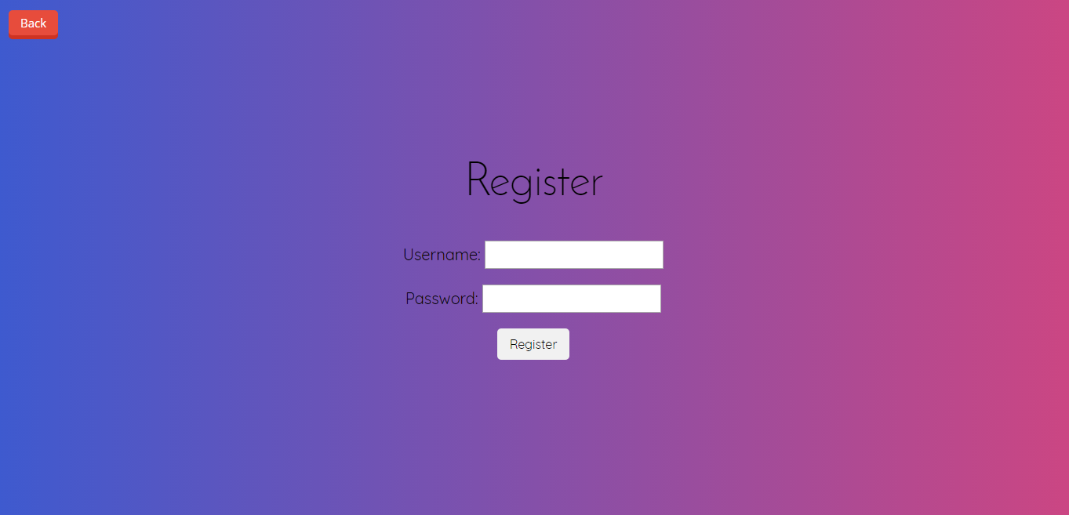
The Register Page

Slide 8

The Login Page

Slide 9
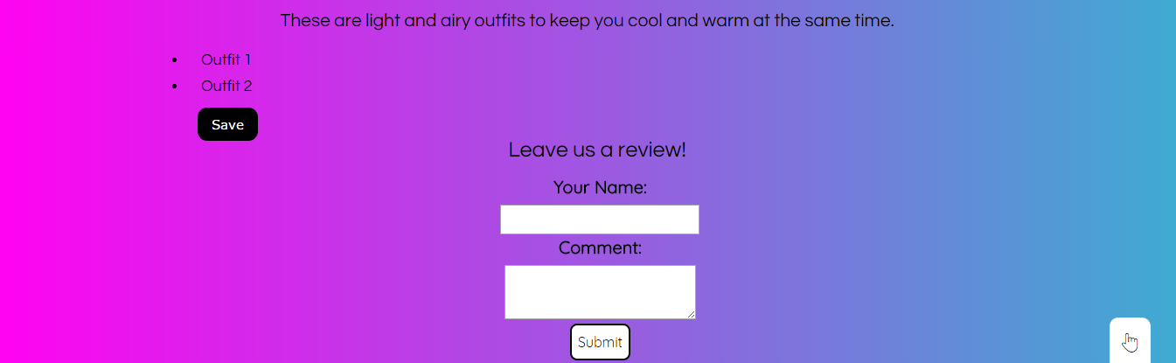
The Review Form/Save Button/Description For Both Boys & Girls

Slide 10

The Personal Closet

